Slide 1
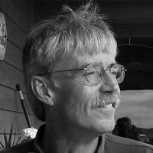
How to Get a 16 Year Old a Job
Roger Shelley
Volume 4

Slide 2
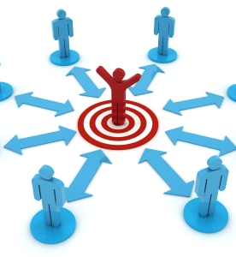
Aspects & Partnerships
Social Networking

Slide 3
Let’s Review the Aspects
How to Get a 16 Year Old a Job
Public Employment Resources
SSA Work Incentives
Customized Employment Strategies
Social Networking
Job Related Routines

Slide 4
Let’s Review the Aspects
How to Get a 16 Year Old a Job
Public Employment Resources
SSA Work Incentives
Customized Employment Strategies
Social Networking
Job Related Routines

Slide 5
Essential Social Capital & Networking
Social Capital Focuses on
Who knows Whom (Social Networks)
The Character of these Networks
The Strength of our Ties
Levels of Trust
Levels of Reciprocity
Hammis, D., Griffin-Hammis, LLC

Slide 6
Your Team From Wheeler, C. UAA CHD Tapestry
Everyone needs to have people to talk to about their lives.
Everyone needs to have people they can trust to help them make decisions.
In this assignment you will list those people in you life!

Slide 7
Economic Exchange
Participation
Friendship
Inner Circle/ Intimate
Your
Team

Slide 8
Economic Exchange
Participation
Inner Circle/Intimate:
List the people you are the closest to
Examples: mom, dad, aunts, uncles, brothers, sisters, girlfriends, grandparents, best friends
Friendship
Inner Circle/ Intimate
Your Team

Slide 9
Economic Exchange
Participation
Friendship:
List your friends that you do things with, like hang out, go to movies, go on adventures, call on the phone
Examples: friends from school, friends from church, neighbors, extended family
Friendship
Inner Circle/ Intimate
Your Team

Slide 10
Economic Exchange
Participation
Participation:
List the people you know through activities you do, people you don’t see unless you are doing the activity
Examples: people you know through Special Olympics, ARC dances, church groups, clubs, family friends
Friendship
Inner Circle/ Intimate
Your Team

Slide 11
Economic Exchange
Participation
Economic Exchange:
List the people you know only because they are paid, and only those people you talk to every time you meet
Examples: agency staff, barber, bank tellers, store cashiers, people who help you in stores
Friendship
Inner Circle/ Intimate
Your Team

Slide 12
Essential Social Capital & Networking
Social Networks Matter
Thick Trust: where trust extends only to known friends & associates
Thin Trust: where trust extends to include total strangers
Hammis, D. Griffin-Hammis Associates, LLC

Slide 13
Essential Social Capital & Networking
Trust Growing Elements
Repeated exposure & shared spaces
Honesty in Communications
Follow-Through on Commitments
Consistency in Behavior
Hammis, D. Griffin-Hammis Associates, LLC

Slide 14
Types of Social Capital
Public-Regard: we are tied to formal groups (City Council; PTA; People First; Kiwanis)
Private Regard: we are tied to informal groups (Church; Softball team; Neighborhood Watch)
Formal vs. Informal: (Bylaws & Committees vs. Social/Interest/Hobby relationships)
Hammis, D, Griffin-Hammis Associates, LLC

Slide 15
Types of Social Capital
The development of social capital within your community is an essential aspect of community engagement and membership
How are we promoting it for our young jobseekers?
Community groups, church, sports, school activities?

Slide 16
Social Capital Exercise
List all past and present community organizations in which you or your family participate.
Which ones would you like to become a member? Why? How?

